Slide 1
Alphabet Detection
CSE-4128: Image Processing and Computer Vision Laboratory
Submitted to
Dr. Sk. Md. Masudul Ahsan
Professor
Department of CSE, KUET
Dipannita Biswas
Lecturer
Department of CSE, KUET
Submitted by Doniel Tripura
Roll : 1907121
Department of CSE, KUET

Slide 2
Outline
Introduction
Methodology
Result Analysis
Recommendations & findings
Conclusion

Slide 3
Introduction
Alphabet detection is a critical component in various applications such as
optical character recognition (OCR),
automated text reading systems, and
image processing tasks.
The primary goal of this project is to accurately identify and classify English alphabets (A-Z, a-z) from images using traditional image processing techniques.

Slide 4
Introduction cont.
Alphabet Detection system can recognize English alphabet (A-Z, a-z) from an input image.
The input image may have multiple alphabets.
The alphabets could be in different sizes.
The system will detect the alphabets and results the combined output as string.

Slide 5
Methodology
Image Acquisition
Obtain the input image
Contour Detection
Find contour
Sort contour
Segment Extraction
Bounding Rectangle
Extract segment
Template Matching
Preprocess templates
Compare templates
Alphabet Recognition
Identify Matches
Show results
Preprocessing
Gaussian blur
Grayscale conversion
Thresholding

Slide 6

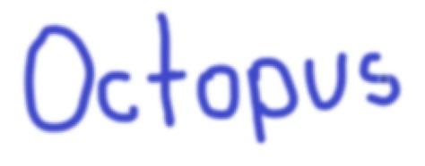
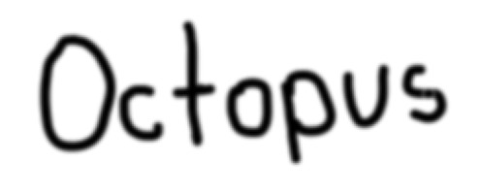

Methodology cont.
Preprocessing
Fig 1: Input Image
Fig 2: Gaussian Blur Image
Fig 3: Grayscale Image
Fig 4: Image after thresholding

Slide 7
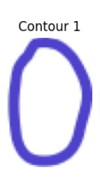

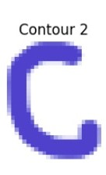

Methodology cont.
Contour detection & segment extraction
1. Contour 1:
Fig 5: Contour 1
2. Contour 2:
Fig 6: Contour 2

Slide 8
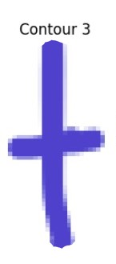

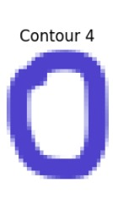

Methodology cont.
Contour detection & segment extraction
3. Contour 3:
Fig 7: Contour 3
4. Contour 4:
Fig 8: Contour 4

Slide 9
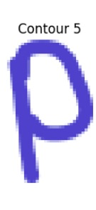



Methodology cont.
Contour detection & segment extraction
5. Contour 5:
Fig 9: Contour 5
6. Contour 6:
Fig 10: Contour 6

Slide 10


Methodology cont.
Contour detection & segment extraction
7. Contour 7:
Fig 11: Contour 7

Slide 11
Methodology cont.
Lets say an image I is a 5*5 matrix, and template T is a 3*3 matrix.
I₁₁ | I₁₂ | I₁₂ | I₁₄ | I₁₅
I₂₁ | I₂₂ | I₂₃ | I₂₄ | I₂₅
I₃₁ | I₃₂ | I₃₃ | I₃₄ | I₃₅
I₄₁ | I₄₂ | I₄₃ | I₄₄ | I₄₅
I₅₁ | I₅₂ | I₅₃ | I₅₄ | I₅₅
S₁₁ | S₁₂ | S₁₂
S₂₁ | S₂₂ | S₂₃
S₃₁ | S₃₂ | S₃₃
Segment1 =
T₁₁ | T₁₂ | T₁₂
T₂₁ | T₂₂ | T₂₃
T₃₁ | T₃₂ | T₃₃
I =
T =

Slide 12
Methodology cont.
Lets say an image I is a 5*5 matrix, and template T is a 3*3 matrix.
I₁₁ | I₁₂ | I₁₂ | I₁₄ | I₁₅
I₂₁ | I₂₂ | I₂₃ | I₂₄ | I₂₅
I₃₁ | I₃₂ | I₃₃ | I₃₄ | I₃₅
I₄₁ | I₄₂ | I₄₃ | I₄₄ | I₄₅
I₅₁ | I₅₂ | I₅₃ | I₅₄ | I₅₅
T₁₁ | T₁₂ | T₁₂
T₂₁ | T₂₂ | T₂₃
T₃₁ | T₃₂ | T₃₃
I =
T =

Slide 13
Methodology cont.
Lets say an image I is a 5*5 matrix, and template T is a 3*3 matrix.
Segment 1
I₁₁ | I₁₂ | I₁₂ | I₁₄ | I₁₅
I₂₁ | I₂₂ | I₂₃ | I₂₄ | I₂₅
I₃₁ | I₃₂ | I₃₃ | I₃₄ | I₃₅
I₄₁ | I₄₂ | I₄₃ | I₄₄ | I₄₅
I₅₁ | I₅₂ | I₅₃ | I₅₄ | I₅₅
T₁₁ | T₁₂ | T₁₂
T₂₁ | T₂₂ | T₂₃
T₃₁ | T₃₂ | T₃₃
I =
T =

Slide 14
Methodology cont.
Lets say an image I is a 5*5 matrix, and template T is a 3*3 matrix.
Segment 2
I₁₁ | I₁₂ | I₁₂ | I₁₄ | I₁₅
I₂₁ | I₂₂ | I₂₃ | I₂₄ | I₂₅
I₃₁ | I₃₂ | I₃₃ | I₃₄ | I₃₅
I₄₁ | I₄₂ | I₄₃ | I₄₄ | I₄₅
I₅₁ | I₅₂ | I₅₃ | I₅₄ | I₅₅
T₁₁ | T₁₂ | T₁₂
T₂₁ | T₂₂ | T₂₃
T₃₁ | T₃₂ | T₃₃
I =
T =

Slide 15
Methodology cont.
Lets say an image I is a 5*5 matrix, and template T is a 3*3 matrix.
Segment 3
I₁₁ | I₁₂ | I₁₂ | I₁₄ | I₁₅
I₂₁ | I₂₂ | I₂₃ | I₂₄ | I₂₅
I₃₁ | I₃₂ | I₃₃ | I₃₄ | I₃₅
I₄₁ | I₄₂ | I₄₃ | I₄₄ | I₄₅
I₅₁ | I₅₂ | I₅₃ | I₅₄ | I₅₅
T₁₁ | T₁₂ | T₁₂
T₂₁ | T₂₂ | T₂₃
T₃₁ | T₃₂ | T₃₃
I =
T =

Slide 16
Methodology cont.
Lets say an image I is a 5*5 matrix, and template T is a 3*3 matrix.
Segment 4
I₁₁ | I₁₂ | I₁₂ | I₁₄ | I₁₅
I₂₁ | I₂₂ | I₂₃ | I₂₄ | I₂₅
I₃₁ | I₃₂ | I₃₃ | I₃₄ | I₃₅
I₄₁ | I₄₂ | I₄₃ | I₄₄ | I₄₅
I₅₁ | I₅₂ | I₅₃ | I₅₄ | I₅₅
T₁₁ | T₁₂ | T₁₂
T₂₁ | T₂₂ | T₂₃
T₃₁ | T₃₂ | T₃₃
I =
T =

Slide 17
Methodology cont.
Lets say an image I is a 5*5 matrix, and template T is a 3*3 matrix.
Segment 5
I₁₁ | I₁₂ | I₁₂ | I₁₄ | I₁₅
I₂₁ | I₂₂ | I₂₃ | I₂₄ | I₂₅
I₃₁ | I₃₂ | I₃₃ | I₃₄ | I₃₅
I₄₁ | I₄₂ | I₄₃ | I₄₄ | I₄₅
I₅₁ | I₅₂ | I₅₃ | I₅₄ | I₅₅
T₁₁ | T₁₂ | T₁₂
T₂₁ | T₂₂ | T₂₃
T₃₁ | T₃₂ | T₃₃
I =
T =

Slide 18
Methodology cont.
Lets say an image I is a 5*5 matrix, and template T is a 3*3 matrix.
Segment 6
I₁₁ | I₁₂ | I₁₂ | I₁₄ | I₁₅
I₂₁ | I₂₂ | I₂₃ | I₂₄ | I₂₅
I₃₁ | I₃₂ | I₃₃ | I₃₄ | I₃₅
I₄₁ | I₄₂ | I₄₃ | I₄₄ | I₄₅
I₅₁ | I₅₂ | I₅₃ | I₅₄ | I₅₅
T₁₁ | T₁₂ | T₁₂
T₂₁ | T₂₂ | T₂₃
T₃₁ | T₃₂ | T₃₃
I =
T =

Slide 19
Methodology cont.
Lets say an image I is a 5*5 matrix, and template T is a 3*3 matrix.
Segment 7
I₁₁ | I₁₂ | I₁₂ | I₁₄ | I₁₅
I₂₁ | I₂₂ | I₂₃ | I₂₄ | I₂₅
I₃₁ | I₃₂ | I₃₃ | I₃₄ | I₃₅
I₄₁ | I₄₂ | I₄₃ | I₄₄ | I₄₅
I₅₁ | I₅₂ | I₅₃ | I₅₄ | I₅₅
T₁₁ | T₁₂ | T₁₂
T₂₁ | T₂₂ | T₂₃
T₃₁ | T₃₂ | T₃₃
I =
T =

Slide 20
Methodology cont.
Lets say an image I is a 5*5 matrix, and template T is a 3*3 matrix.
Segment 8
I₁₁ | I₁₂ | I₁₂ | I₁₄ | I₁₅
I₂₁ | I₂₂ | I₂₃ | I₂₄ | I₂₅
I₃₁ | I₃₂ | I₃₃ | I₃₄ | I₃₅
I₄₁ | I₄₂ | I₄₃ | I₄₄ | I₄₅
I₅₁ | I₅₂ | I₅₃ | I₅₄ | I₅₅
T₁₁ | T₁₂ | T₁₂
T₂₁ | T₂₂ | T₂₃
T₃₁ | T₃₂ | T₃₃
I =
T =

Slide 21
Methodology cont.
Lets say an image I is a 5*5 matrix, and template T is a 3*3 matrix.
Segment 9
I₁₁ | I₁₂ | I₁₂ | I₁₄ | I₁₅
I₂₁ | I₂₂ | I₂₃ | I₂₄ | I₂₅
I₃₁ | I₃₂ | I₃₃ | I₃₄ | I₃₅
I₄₁ | I₄₂ | I₄₃ | I₄₄ | I₄₅
I₅₁ | I₅₂ | I₅₃ | I₅₄ | I₅₅
T₁₁ | T₁₂ | T₁₂
T₂₁ | T₂₂ | T₂₃
T₃₁ | T₃₂ | T₃₃
I =
T =

Slide 22
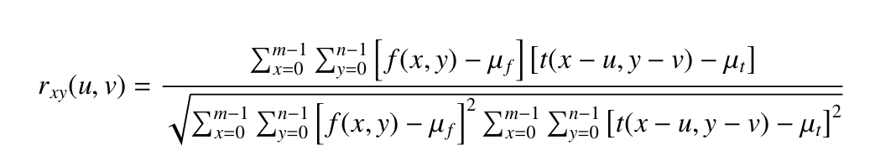
Methodology cont.
Cross-Correlation
Segment 1
Template
I₁₁ | I₁₂ | I₁₂
I₂₁ | I₂₂ | I₂₃
I₃₁ | I₃₂ | I₃₃
T₁₁ | T₁₂ | T₁₂
T₂₁ | T₂₂ | T₂₃
T₃₁ | T₃₂ | T₃₃
s1 =
T =
The greater the correlation value, the more similar they are.

Slide 23
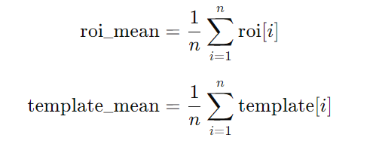
Cross-Correlation Calculation
Calculate the Mean Values:
Calculate the mean of the segment (roi_mean) and the mean of the template (template_mean).
where n is the total number of elements in the segment or template (in this case, n=9).

Slide 24
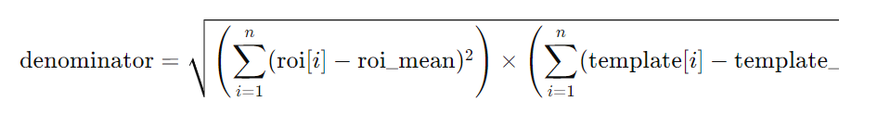

Cross-Correlation Calculation
2. Calculate the Cross-Correlation for the Template:
For each position of the template over the segment, compute the following:
Region of Interest (ROI): Extract the region from the segment that matches the size of the template.
Denominator: Calculate the denominator of the correlation formula:
Numerator: Calculate the numerator of the correlation formula:

Slide 25

Cross-Correlation Calculation
Correlation Value: Compute the correlation value:
The greater the correlation value, the more similar they are.
Higher Correlation Value: Indicates a greater similarity between the segment (or region of interest, ROI) and the template. A high correlation value means that the template and the ROI have similar patterns, which suggests a good match.
Lower Correlation Value: Indicates less similarity. A lower correlation value means the patterns in the ROI and the template are less similar.

Slide 26
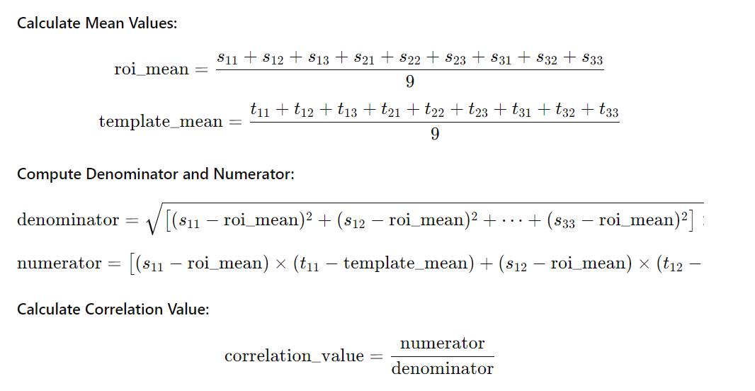
Cross-Correlation Calculation ex.

Slide 27
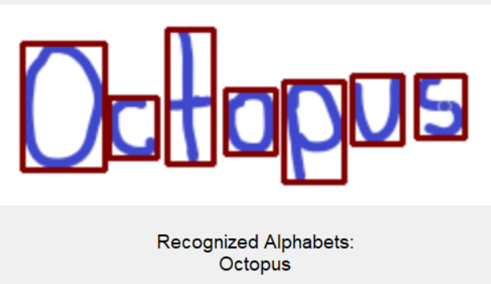

Result Analysis
Fig 12: Input image
Fig 13: Result

Slide 28
Result Analysis cont.
Table 1: Performance of the alphabet detection system across different datasets
Dataset Type | Dataset Size | Accuracy
Calibri Body | 26 images | 100%
Times New Roman | 26 images | 48%
Hand-Written | 26 images | 76.92%

Slide 29
Result Analysis cont.
Table 1: Performance of the alphabet detection system across different datasets
Dataset Type | Dataset Size | Accuracy
Calibri Body | 26 images | 100%
Hand-Written | 26 images | 76.92%

Slide 30
Recommendations and findings
Findings
Multiple Contours Issue
Contour Detection Challenges
Effectiveness of Preprocessing
Impact of Dataset Characteristics
4.1. Font Characteristics (stroke width, spacing, and letter shapes)
4.2. Template Quality and Variation

Slide 31
Recommendations and findings cont.
Recommendations
Alternative Contour Detection Methods
Advanced Preprocessing Techniques
Character Segmentation Enhancement
Dataset Enrichment
System Optimization and Testing
Integration of Post-Processing Techniques

Slide 32
Conclusions
In conclusion, the alphabet detection system proves to be effective for alphabet detection in controlled environments.
Future enhancements could include the integration of advanced machine learning models to address challenges posed by varying text styles and image conditions.

Slide 33
THANK YOU!

